Slide 1


Chapter 4
VLAN Trunking Protocol
(VTP)

Slide 2
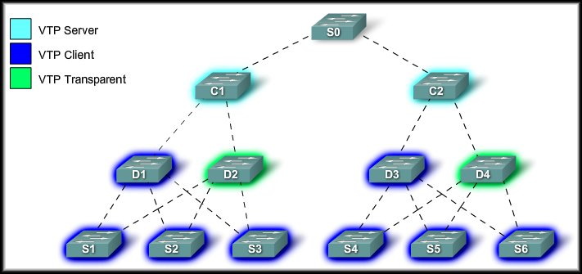
VLAN Trunking Protocol
VTP Concepts

Slide 3
What is VTP?
The VLAN Trunking Protocol (VTP) allows you to simplify the management of the VLAN database across multiple switches.
As the number of switches increases on a small- or medium-sized business network, the overall administration required to manage VLANs and trunks in a network becomes a challenge.

Slide 4

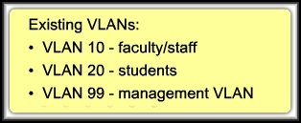
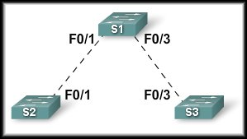
What is VTP?
Simple Network.
Create VLAN 30
Choose interface(s).
Add interface(s) to VLAN 30.

Slide 5
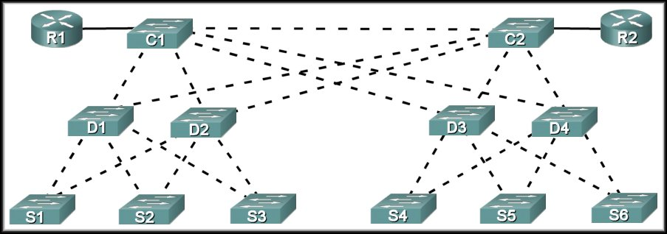
What is VTP?
How about now?

Slide 6
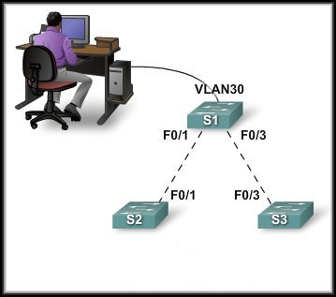



What is VTP?
How does it work?
VTP Server
VLAN 30
VLAN 30

Slide 7
Benefits of VTP
The VLAN Trunking Protocol (VTP) allows you to simplify the management of the VLAN database across multiple switches.
Benefits:
  VLAN configuration consistency across the entire network.
  Accurate tracking and monitoring of VLANs.
  Dynamic reporting of added VLANs across a network.

Slide 8
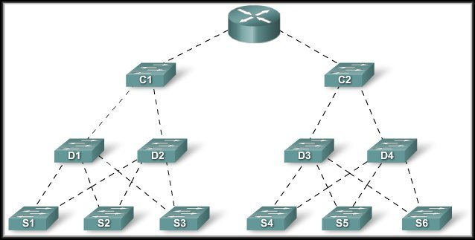
VTP Components
VTP Domain:
  Consists of one or more interconnected switches.
  All switches in a domain share VLAN configuration details using VTP advertisements.
  Router or Layer 3 switch defines the boundary of domain.

Slide 9
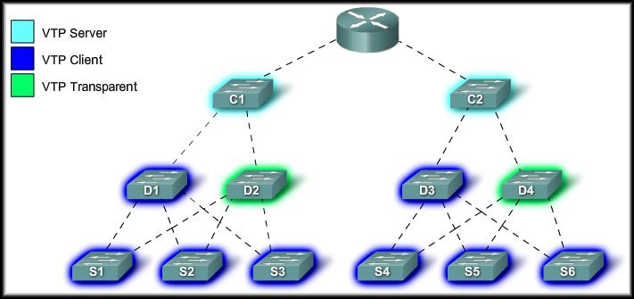
VTP Components
VTP Modes:
  Three different modes:
    Server, Client, Transparent

Slide 10
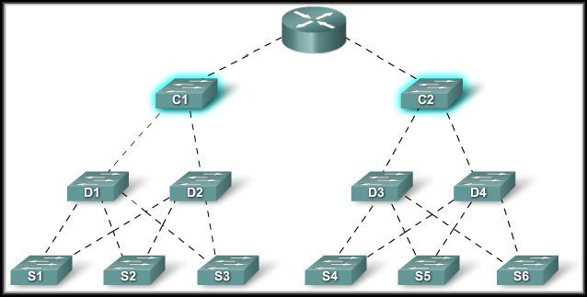
VTP Components
VTP Server:
  VTP servers advertise the VTP VLAN information to other switches in the same VTP domain.
  The server is where VLANs can be created, deleted, or renamed for the domain.

Slide 11
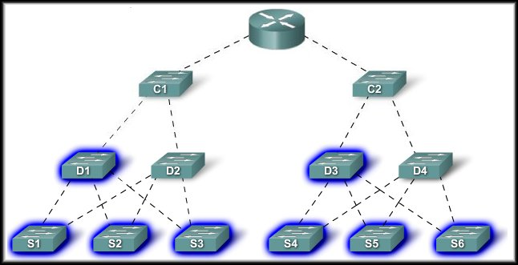
VTP Components
VTP Client:
  VTP clients Forward advertisements to other clients.
  You cannot create, change, or delete VLANs.
  You must configure VTP Client mode.

Slide 12
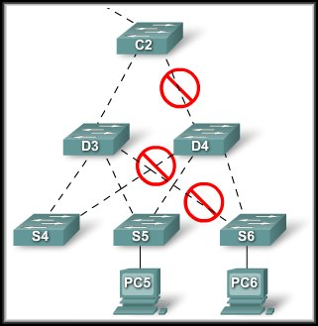
VTP Components
VTP Pruning:
  VTP pruning increases network available bandwidth by restricting flooded traffic to those
  trunk links used to reach the
  destination devices.
  Without VTP pruning, broadcasts,
  multicasts and unknown unicasts
  are flooded across all trunk links
  within a VTP domain.
  What it means is that the
  destination switch does not have
  the same VLAN as the switch
  that initiates the broadcast.

Slide 13
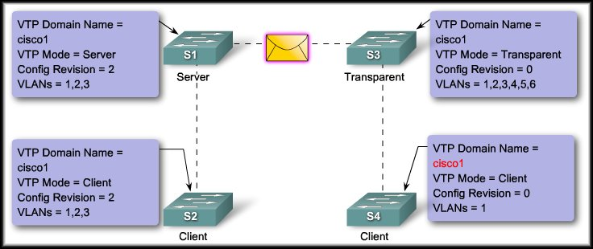
VLAN Trunking Protocol
VTP Operation

Slide 14
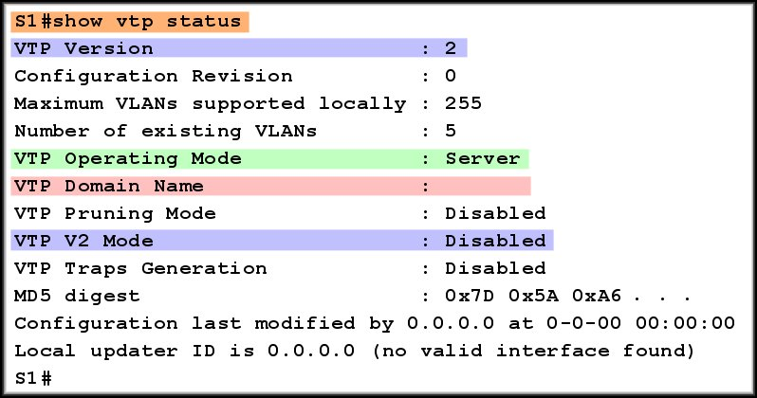
Default VTP Configuration
The version the switch is capable of running. Default is Version 1.
Server Mode
NO
Domain Name
Version 2 Disabled

Slide 15
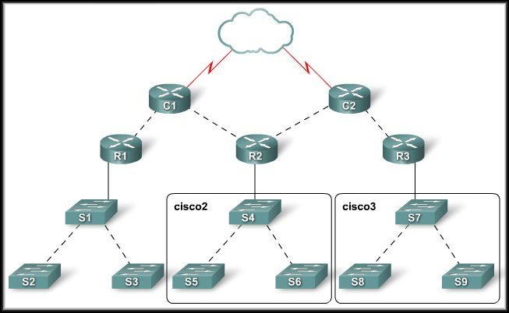
VTP Domains
VTP allows you to separate your network into smaller management domains to help reduce VLAN management.
A switch can be a
member of only one
VTP domain at a time.
Until the VTP domain
name is specified, you
cannot create or modify
VLANs on a VTP server,
and VLAN information is not propagated over the network.

Slide 16
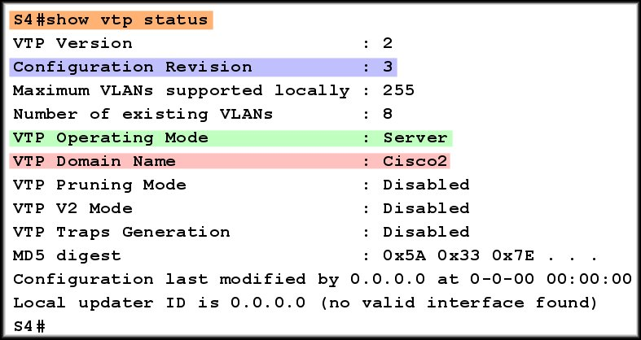
VTP Domains
Two domains configured.

Slide 17
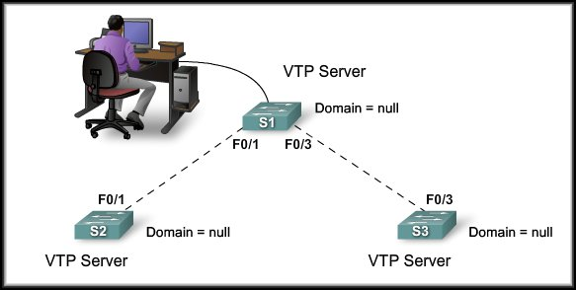

VTP Domains
For a VTP server or client switch to participate in a VTP-enabled network, it must be a part of the same domain.
Domain name propagation uses three VTP components: servers, clients, and advertisements.

Slide 18
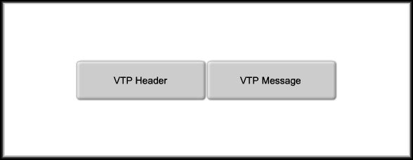
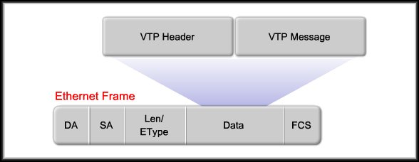
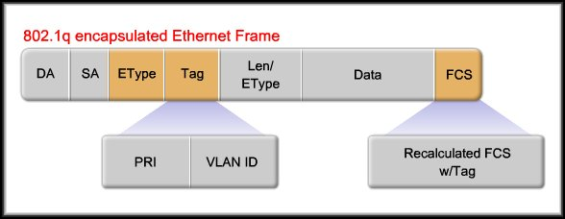
VTP Advertising
VTP Frame Structure:
  VTP advertisements (or messages) distribute VTP domain name and VLAN configuration changes to VTP-enabled switches.
  The VTP frame is encapsulated in the same manner as any other tagged frame.

Slide 19
VTP Revision Number
VTP Revision Number (Default Zero):
  The configuration revision number is a 32-bit number that indicates the level of revision for a VTP frame.
  Each time a VLAN is added or removed, the configuration revision number is incremented.
  Each VTP device tracks the VTP configuration revision number.
  A VTP domain name change resets the revision number to zero.
The revision number plays an important role in enabling VTP to distribute and synchronize VTP domain and VLAN configuration information. (More to come)

Slide 20
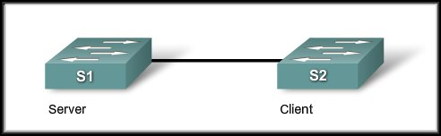

VTP Advertisement Types
Summary Advertisement:
  Contains the VTP domain name, the current revision number, and other VTP configuration details.
  Summary advertisements are sent:
    Every 5 minutes by a VTP server or client to inform neighboring VTP-enabled switches of the current VTP configuration revision number for its VTP domain.
    Immediately after a configuration change.

Slide 21

VTP Advertisement Types
Subset Advertisement:
  A subset advertisement contains VLAN information.
  Changes that trigger the subset advertisement include:
    Creating or deleting a VLAN.
    Suspending or activating a VLAN.
    Changing the name of a VLAN.
    Changing the MTU of a VLAN.

Slide 22

VTP Advertisement Types
Request Advertisement:
  A request advertisement is sent to a VTP server.
  The VTP server responds to the client by sending a summary advertisement followed by a subset advertisement.
  Request advertisements are sent if:
    The VTP domain name has been changed.
    The switch receives a summary advertisement with a higher configuration revision number than its own.
    A subset advertisement message is missed for some reason.
    The switch has been reset.

Slide 23
VTP Advertisement Types
Details of the formats can be found in the text or in the online curriculum.
  Summary Advertisement
  Subset advertisement
  Request Advertisement

Slide 24
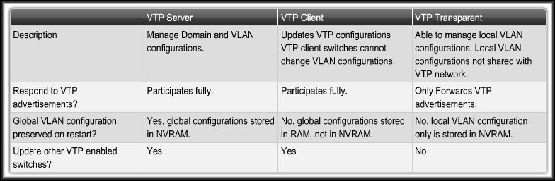
VTP Modes
A Cisco switch can be configured in either:
  Server mode
  Client mode
  Transparent mode
These modes differ in how they are used to manage and advertise VTP domains and VLANs.

Slide 25
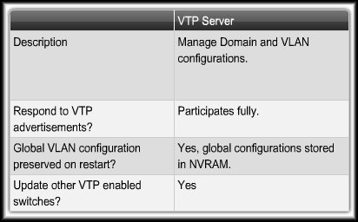
VTP Modes
VTP Server Mode:

Slide 26
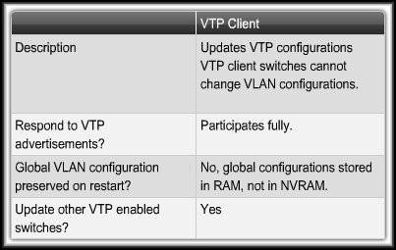
VTP Modes
VTP Client Mode:

Slide 27
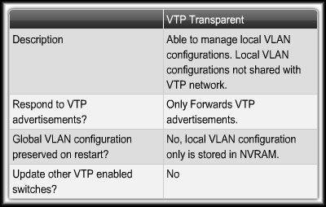
VTP Modes
VTP Transparent Mode:

Slide 28
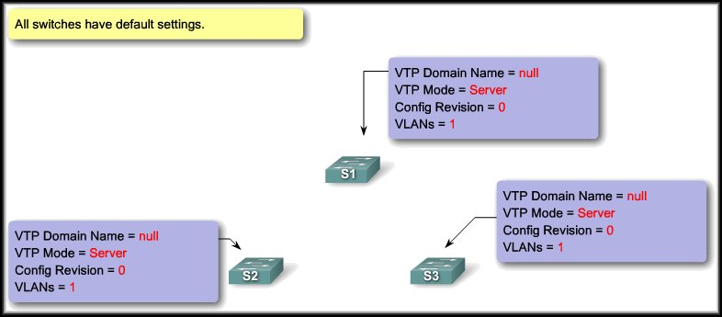
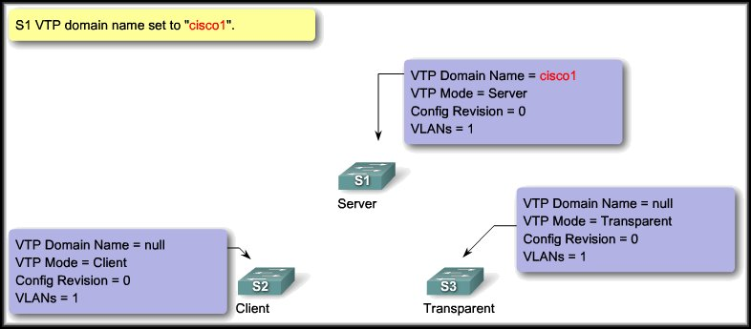
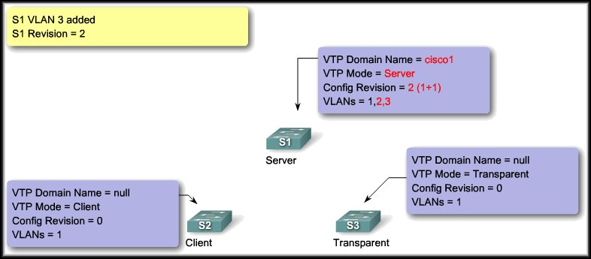
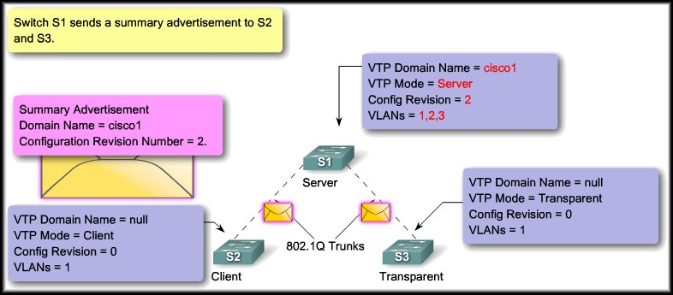
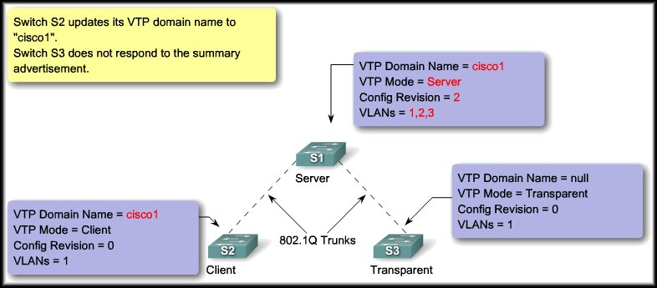
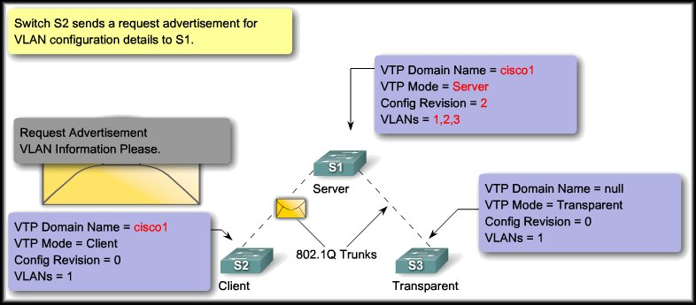
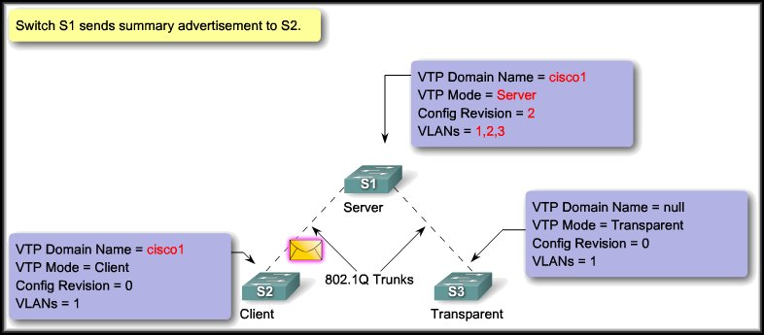
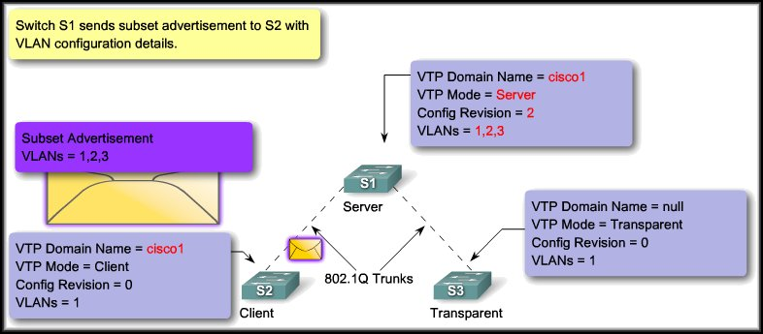
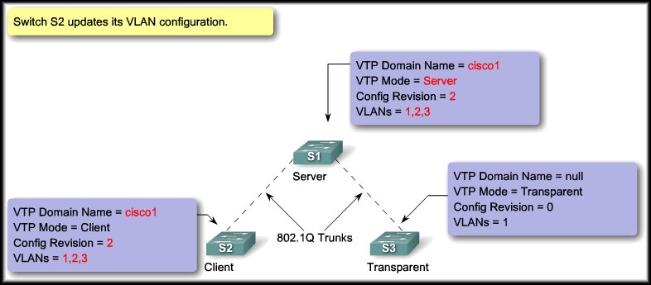
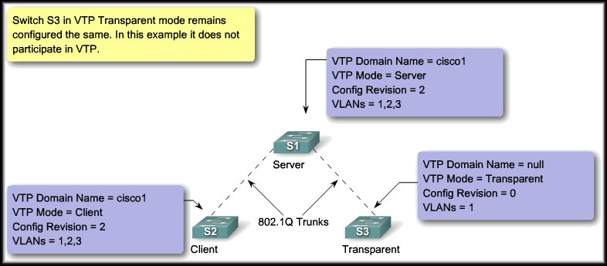
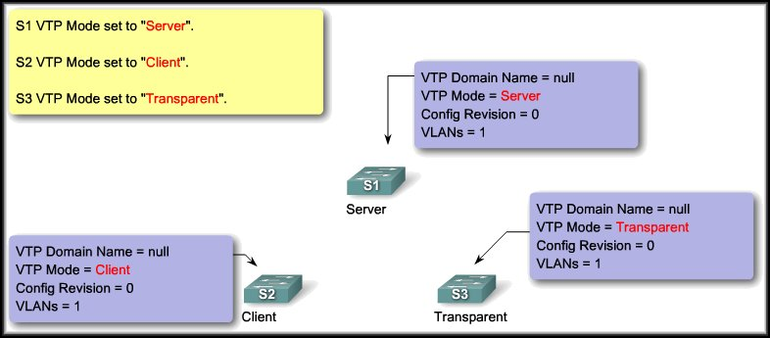
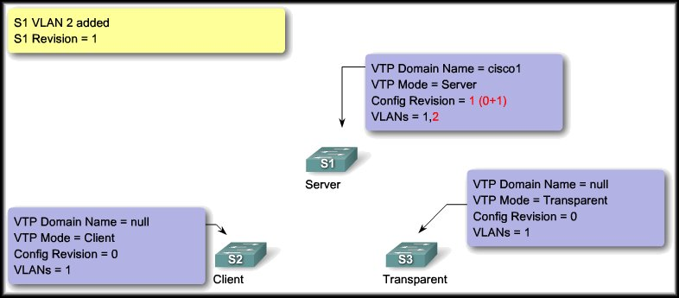
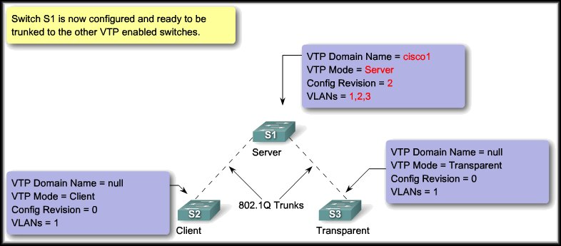
VTP – Server to Client

Slide 29
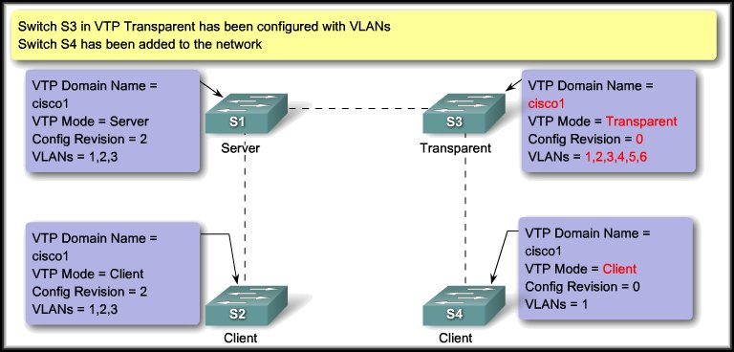
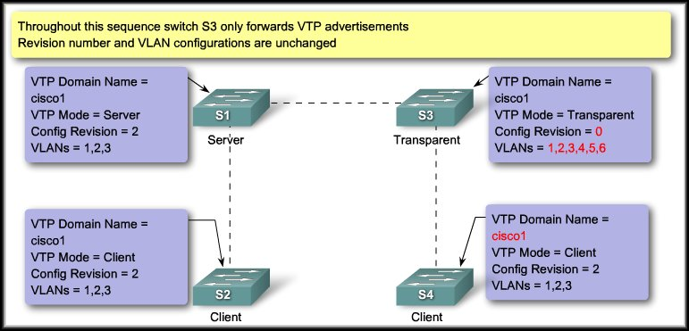



VTP – Server to Transparent to Client
S1 Periodic Updates
S1 Response
S4
Requests

Slide 30
VTP Pruning
VTP Pruning:
  Prevents unnecessary flooding of broadcast information from one VLAN across all trunks in a VTP domain.
  Permits switches to negotiate which VLANs are assigned to ports at the other end of a trunk and prune the VLANs that are not assigned to ports on the remote switch.
  Disabled by default.
  Enabled using the vtp pruning global configuration command.

Slide 31
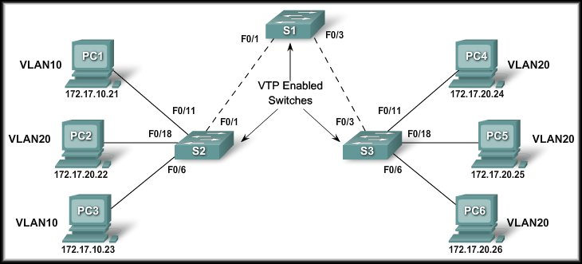
VTP Pruning
No pruning
VLAN 10, 20
VLAN 20
Pruning enabled on S1

Slide 32
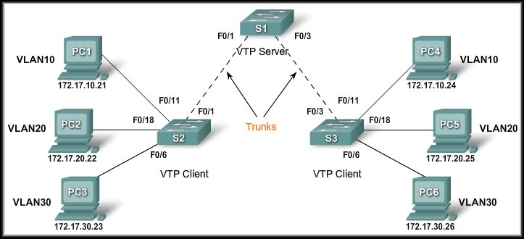
VLAN Trunking Protocol
Configure VTP

Slide 33
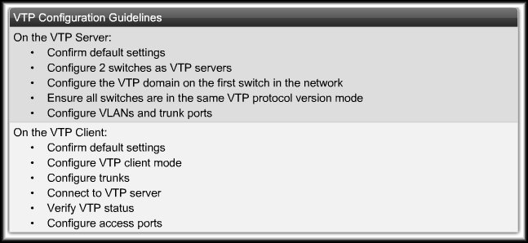
Configuring VTP
Configuration Guidelines:

Slide 34
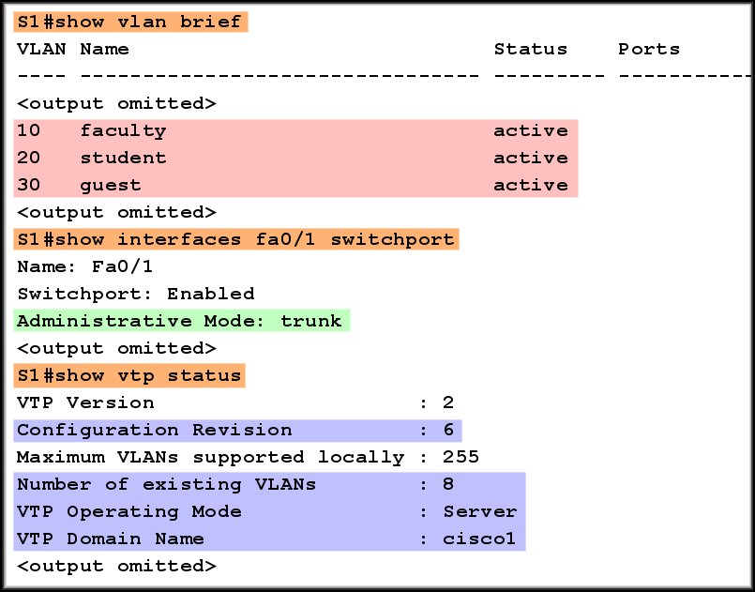
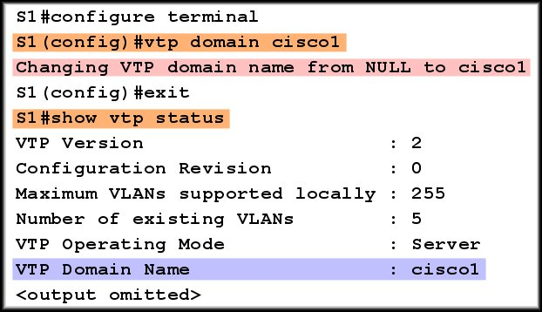
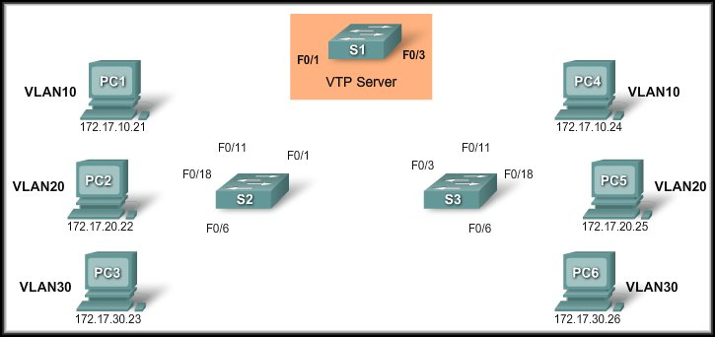
Configuring VTP
VTP Server Configuration:
Adding a name to a VLAN is considered a revision.
3 VLANs + 3 Names = 6

Slide 35
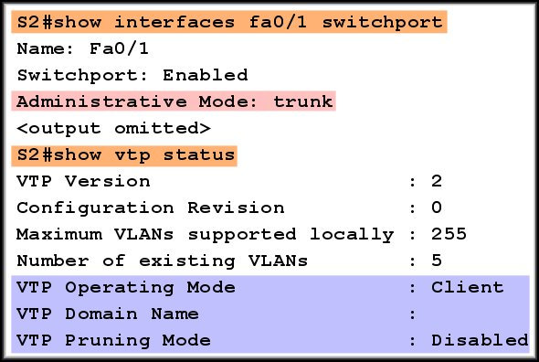
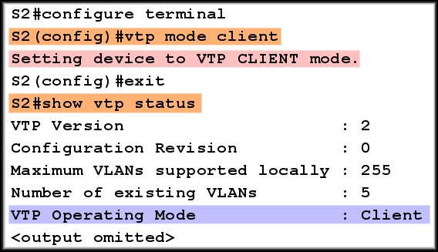
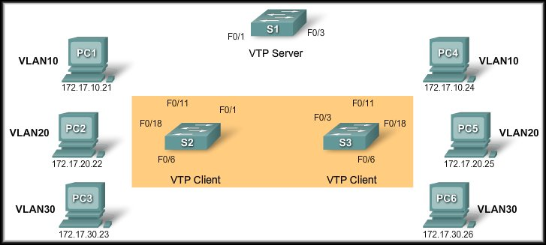
Configuring VTP
VTP Client Configuration:

Slide 36
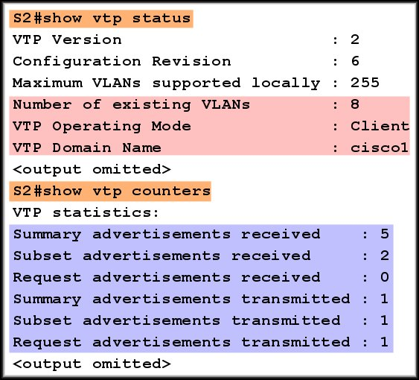
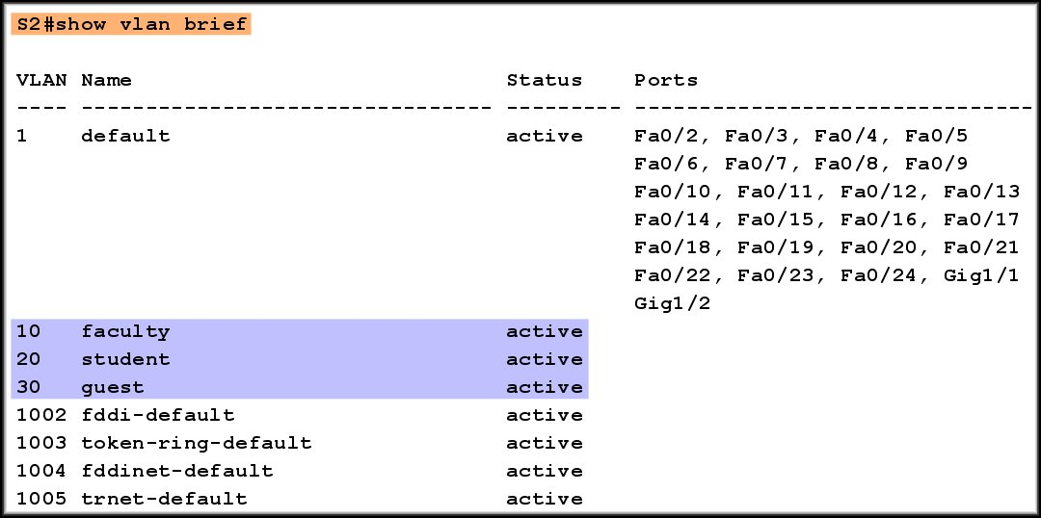
Configuring VTP
Connect the Devices and Verify VTP:

Slide 37
Configuring VTP
Add the workstations to the appropriate VLAN.
  Use the show vlan brief command to verify.

Slide 38
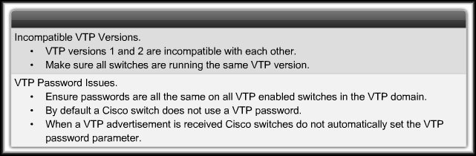


Troubleshooting VTP Configurations

Slide 39



Troubleshooting VTP Configurations
Incorrect VTP Domain Name
Update
Not updated

Slide 40


Troubleshooting VTP Configurations
All switches set to Client mode.
On a reboot, all VLAN configurations are lost. VTP clients do not store the configuration in NVRAM.

Slide 41









Troubleshooting VTP Configurations
Incorrect Revision Number

Slide 42




Managing VLANs on a VTP Server

